Slide 1
Social Security Disability and the Affordable Care Act

Slide 2
Problem
The Patient Protection and Affordable Care Act (ACA) was enacted in 2010 and went fully into effect in 2014
Intended to improve access and affordability of health insurance
Prior to the ACA, one vector for individuals to obtain health insurance regardless of pre-existing conditions was to qualify for Social Security disability
After one year on Supplemental Security Income (SSI) you are eligible for Medicaid
After two years on Social Security Disability Insurance (SSDI) you are eligible for Medicaid
With the ACA in place, this incentive to go on disability may be reduced, as the ACA marketplaces and Medicaid expansion improve access, regardless of pre-existing conditions
On the other hand, with the ACA in place, you have access to health insurance outside a job, which may in some cases incentivize use of the program
CBO, in congressional testimony prior to the ACA, said “the Affordable Care Act is likely to influence application rates for the DI [disability insurance] program, but whether it will result in more or fewer beneficiaries is difficult to predict”
This project is an attempt to determine the possible effects of the ACA on disability enrollments using early ACA enrollment data recently made available.

Slide 3
Data
ACA Enrollment data: Annual (final) Enrollment Reports published by the US Department of Health and Human Services.
Economic Data (GDP, Personal Income, Employment, Compensation, Wages): The US Department of Commerce, Bureau of Economic Analysis to obtain series by State and Nationally
Demographic Data (Age of Population, Poverty Rates) and necessary reference data (State/Region mapping and State Name/State Code): US Census Bureau.
Data on the Medicaid Expansion: Kaiser Family Foundation website.
Data was obtained on a yearly, State-by-State and national level and constructed into a longitudinal panel

Slide 4
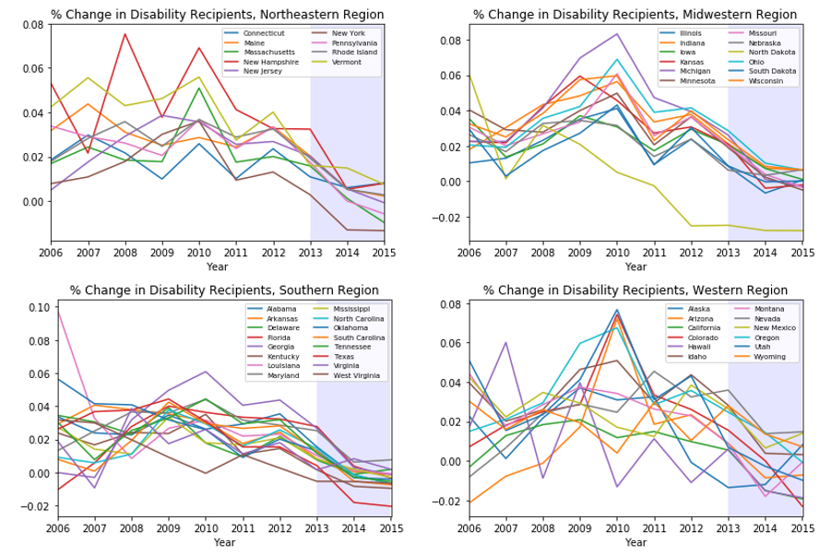
Visualizations

Slide 5
Models
PanelOLS (from linearmodels) fixed effects model
Used forward stepwise selection with the f-statistic as the scoring function
One-period lagged Employment to Population ratio was the only regressor chosen
R-squared of only .22
No additional variables in my dataset improved the model
Wald tests for structural break – no unique structural break in the time series
One year of data available on ACA utilization
Two additional regressors: ACA Marketplace enrollment and Medicaid Expansion
Added to the model with lagged EPOP ratio
Used fixed effects estimated by PanelOLS as the group intercepts
Additional Linear Model estimated without ACA Marketplace Enrollment and Medicaid Expansion
Non-linear (Kernel Ridge Regression) model included for pedagogical reasons (hyperparameter tuning)
Test train sets created from 50 datapoints available for the year
Predictive power of all models was minimal

Slide 6
Conclusion
No conclusion could be reached regarding the question of interest
Dataset did not have enough significant independent variables to control for economic and demographic changes at the State level
Dataset was constructed column by column from multiple data sources – not a well known, readily available data set
For purposes of this sort of project, an excess of data wrangling is not advisable – you can find yourself with a lot of work done but not the right pieces of information to develop useful models
As an exercise in data wrangling in pandas and learning various parts of the linearmodels, statsmodels and sklearn apis, it was a useful experience

